Slide 1
Team ID: c_uragiw
Gautam Worah
Aditya Govil
Cameron Nelson
Fahmid Morshed Fahid
Notes:
Team introduction (5 seconds)

Slide 2


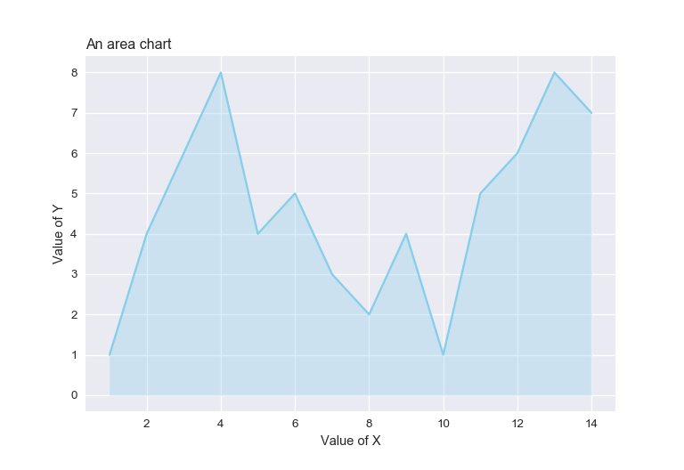
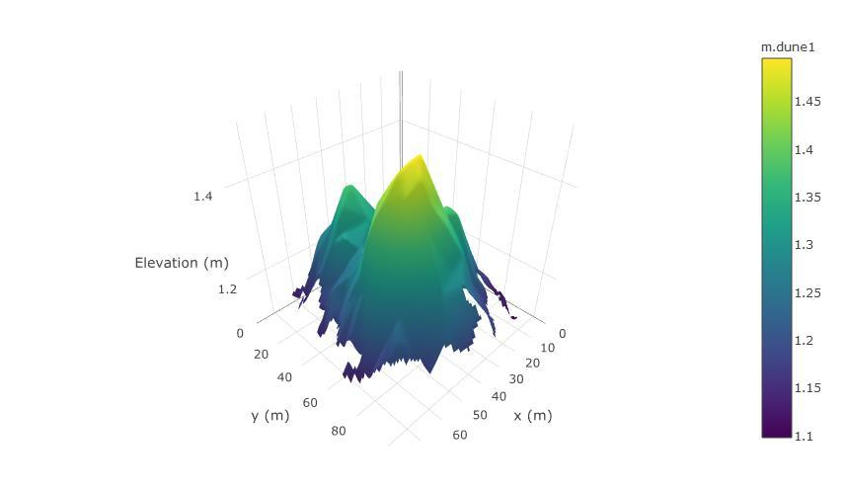
Projects
https://python-graph-gallery.com/241-improve-area-chart/
https://stackoverflow.com/questions/39576455/plotly-3d-surface-graph-has-incorrect-x-and-y-axis-values?rq=1
Notes:
Introduce projects being studied w/ high level description (30 - 35 seconds)
What is matplotlib and Plotly?
Why are we analyzing these two open source projects?

Slide 3
Milestones/Focus Leaders
9 October: Static analysis report from Pylint
23 October: Complete static analysis & bug-finding report from Pylint & PyChecker
6 November: Travis CI report
19 November: Community feedback report
Fahmid & Cameron: Static analysis/bug-finding report
Gautam & Aditya: Community feedback/performance report
Notes:
Milestones/focus leaders breakdown (25 - 30 seconds)

Slide 4
Tools
Tool | Purpose
PyLint | Static analysis
PyChecker | Static analysis
Travis CI | Performance analysis
Github | Understanding community
Notes:
Tools breakdown (30 - 35 seconds)
Pylint and PyChecker: Both static analysis tools are used to check the quality of Python code and report bugs.
Travis CI: Continuous integration tool mostly used in association with Github to gather performance analysis data (i.e. build-time run, code coverage, etc.)
Github: Used to gather community feedback (mentioned in metrics slide). Python script and Github API are used for gathering metrics.

Slide 5
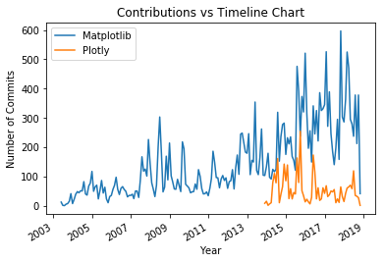
Metrics
Static analysis/Bug-finding:
# of Bugs, Errors, Warnings
# of Modules, Classes, Methods & Functions
Code rating
Code vs. documentation
Community:
# of contributors & forks over time
# of commits & issues over time
Performance
Code coverage
Build time
Notes:
Explain metrics (1 minute - 1 minute 5 seconds)

Slide 6
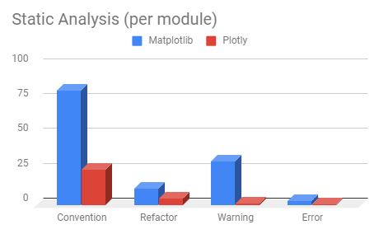
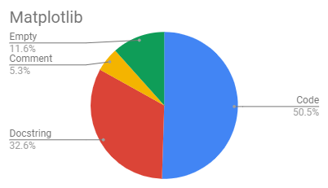
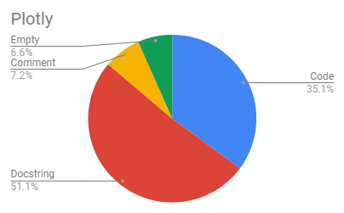
Preliminary Results: Pylint
 | Module | Class | Method | Function
Matplotlib | 125 | 702 | 4446 | 854
Plotly | 840 | 676 | 13600 | 239
Notes:
Explain Pylint report (1 minute - 1 minute 5 seconds)
Table: project scope
Plotly: (Wrapper of plotly js), newer
Supports interactive functionality
Integrates with other languages
Matplotlib: Mid level control, python only, so have more functionality, but plotly is high level viz and easy to use.
Documentation
Matplotlib’s documentation is (stable) throughout every module, class, and function
More contributors, needs better docs
Highly used
Aged
Plotly’s documentation is very poor for modules and classes, but consistent with functions
3000 commits only
Fairly new
Compatible with other languages, eg: Plotly.js is the one more famous (16000 commits)
Plotly is bigger than matplotlib
* (C) convention, for programming standard violation * (R) refactor, for bad code smell * (W) warning, for python specific problems * (E) error, for much probably bugs in the code * (F) fatal, if an error occurred which prevented pylint from doing
A function is a piece of code that is called by name. It can be passed data to operate on (i.e. the parameters) and can optionally return data (the return value). All data that is passed to a function is explicitly passed.
A method is a piece of code that is called by a name that is associated with an object. In most respects it is identical to a function except for two key differences:
A method is implicitly passed the object on which it was called.
A method is able to operate on data that is contained within the class (remembering that an object is an instance of a class - the class is the definition, the object is an instance of that data).
https://stackoverflow.com/questions/155609/whats-the-difference-between-a-method-and-a-function

